Slide 1

The Psychology of Entrepreneurship

Slide 2

Why Psychology?
Product
Strategy
Hiring
Managing
Marketing
Entrepreneurship depends on robust models of Learning
Habit
Behaviour
Desire
Interaction
Expectation

Slide 3

What Are The Psychological Theories Of Entrepreneurship?
Self-Efficacy Theory
This theory looks at an individuals mindset towards achieving a goal and how this mentality is developed. Self-efficacy is essentially the belief in your own ability to control your own behavior, emotions, and motivations. ... For example, a student who has a high level of self-efficacy in mathematics will feel confident in their ability to do well in a tough statistics class. The entrepreneurial self-efficacy is the perception of the confidence of the entrepreneurs in themselves in their own entrepreneurial capacities, before they are laid out to launch out in the business
Locus of Control Theory
This theory analyzes an individual's perception of events and suggests that individuals with an internal locus of control are associated with entrepreneurial intentions. Locus of control is a psychological concept that refers to how strongly people believe they have control over the situations and experiences that affect their lives. In education, locus of control typically refers to how students perceive the causes of their academic success or failure in school.
Self-Competition Theory
This theory suggests that individuals develop the desire to improve themselves and become better than their past selves.

Slide 4
What Are The Psychological Theories Of Entrepreneurship?
Ambiguity Tolerance Theory
This theory posits that individuals who possess a higher tolerance of ambiguity are more likely to succeed in the face of uncertainty.
Passion Theory
This theory looks at the different sources of passion for an entrepreneur and how they provide motivation.

Slide 5
Building A
High Performing Team

Slide 6

Essential Element of Team
Mutual Goals
Interdependent Working Relationships
Individual Commitment
Mutual Accountability
Essential Elements of
Teams

Slide 7
Effective Team Member
Understands and is committed to group goals.
Is friendly, concerned, and interested in others;
Acknowledges and confronts conflict openly;
Listens to others with understanding;
Includes others in decision making process;

Slide 8
Effective Team Member
Recognizes and respects Individual differences
Contributes ideas and Solutions;
Values the ideas and contributions of others
Recognizes and rewards team efforts and
Encourages and appreciates comments about team performance.

Slide 9

THEORIES ANR MODELS OF TEAMWORK
Douglas Theories X and Y
Theory X :
Inherent dislike of work
Need for forcing, threatening, controlling, directing, pursing them to achieve organizational goals
Person prefers being directed in order to avoid responsibility
Money or insecurity acts as prime motivation
Limited creativity in human beings

Slide 10
THEORIES ANR MODELS OF TEAMWORK
Douglas Theories X and Y
Theory Y:
For psychological growth of human beings, physical and mental efforts are necessary in work as in rest or play
Self-direction and self control are exercised by human beings while pursing an objective.
Rewards induce commitment to objectives
Under proper circumstances the average human beings learn to take on responsibility and move towards an objective
Self imposed discipline is more effective than externally imposed
Although creativity and ingenuity are not widely used in most job situations, the capacity to exercise exists widely among the human beings.

Slide 11
The Adair Model :
Achieve the task
Build and maintain the team
Develop the individual

Slide 12
Task
Individual
Team
Common Task
Individual needs
Team Building
The Adair Model

Slide 13
The Adair Model
Task
Clear targets
Standards of performance
Clear responsibilities
Achieve targets
Systemic approach
Individual
Accepted – By leader
By Team
Valued – By Leader
- By Team
Able to contribute
Know what is expected
Growth
Team
Common purpose
Supportive climate
Common identity
Sense of Achievement
Grow and development as unit

Slide 14
The Adair model for accomplishment requires
The task needs work groups or organizations to come into effect because one person alone cannot accomplish it.
The team needs constant promotion and retention of group cohesiveness to ensure that it functions efficiently. The team functions on the 'united we stand, divided we fall' principle.
The individual's needs are the physical ones (salary) and the psychological ones of recognition; sense of purpose and achievement; status; and the need to give and receive from others in a work environment.

Slide 15
For Adair, the task, team and individual needs overlap as follows:
Achieving the task builds the team and satisfies the individuals
If the team needs are not met - if the team lacks cohesiveness - then performance of the task is impaired and individual satisfaction is reduced
If individual needs are not met the team will lack cohesiveness and performance of the task will be impaired

Slide 16
Adair's view is that leadership exists at three different levels:
Team leadership of teams of 5 to 20 people
Operational leadership, where a number of team leaders report to one leader
Strategic leadership of a whole business or organisation, with overall accountability for all levels of leadership

Slide 17
Stages Of Team Formation
Forming:
Period of testing and learning for the group.
Period of considerable anxiety where group members are extremely cautious.
Storming:
Conflict emerges as individuals start to assert themselves.
Members compete for status and position of relative control.

Slide 18
Stages Of Team Formation
Norming:
Group norms emerge
Work standards get set
The groups begin to work cooperatively
Performing:
Group gets structured
Challenges get handled
Group becomes task oriented
High involvement levels are seen

Slide 19
Stages of Team Building
Forming | Awareness | Underdeveloped
Storming | Conflict | Experimenting
Norming | Cooperation | Consolidating
Performing | Productivity | Mature
 | Seperation

Slide 20
TEAM ROLES
Coordinator’s Role: Leader: Group Objective and set agenda
Shaper’s Role: Shape to the team’s efforts
Plant’s Role: Sources of new idea generation
Monitor’s Role: Guide the team
Team Worker / Implementer's Role: Convert decision and strategies into defined and manageable task
Resource Investigator’s Role: provide resource information
Team Man’s role: Provide motivational support
Finisher’s role: Mentioned a permanent sense of urgency

Slide 21
CO-ORDINATOR [ CHAIRMAN ]
Trusting, Dominant with strong commitment for achieving external goals.
Positive Qualities
Calmness under pressure, practical self-discipline, enthusiasm.
Tolerant enough always to listen to others but strong enough to reject their advice.

Slide 22
THE SHAPER
TYPICAL FEATURES
Outgoing, dynamic, tough minded, opportunistic, emotional.
Good at directing attention to the setting of objectiveness and priorities & shaping the outcome of group activities.
POSITIVE QUALITIES
Strong need for achievement.
Capacity to galvanize a team into action.

Slide 23
SOLO PLAYER “PLANTS”
Typical Features
Individualistic, serious-minded, Creative.
Positive Qualities
Brains, Imagination, intellect, knowledge.

Slide 24
RESOURCE INVESTIGATOR
TYPICAL FEATURES
Extroverted, enthusiastic, unanxious, curious, communicative, stable.
POSITIVE QUALITIES
A capacity for contacting people and exploring anything new. An ability to respond to challenge and identify opportunities good sense of timing
ALLOWABLE WEAKNESSES
Liable to lose interest once the initial fascination has passed.

Slide 25
Company Worker/Implementer
Typical Features
Conservative, disciplined, dutiful, predictable, tough minded, trusting, tolerant.
Positive Qualities
Organising-ability, practical common sense, hard working, self-discipline, interest of organization, reach to the top.
Allowable Weaknesses
Lack of flexibility, unresponsiveness to unproven ideas.
Resistance to change.

Slide 26
MONITOR EVALUATOR
Typical features
Sober, unemotional, serious minded, shrewd
Positive Qualities
Judgement, discretion, hard-headedness
Allowable Weaknesses
Lacks inspiration or the ability to motivate others.
Boring/Dry appear slow in decision making.

Slide 27
TEAM MAN
Typical Features
Socially oriented, rather mild, sensitive, understanding, humble, trusting.
Positive Qualities
Good listener, group morale.
An ability to respond to people and to situations and to promote team spirit
Allowable Weaknesses
Indecisiveness at the moments of crisis.

Slide 28
Completer / Finisher
TYPICAL FEATURES
Painstaking, orderly, conscientious, anxious, self control & disciplined.
POSITIVE QUALITIES
A capacity for follow through perfectionism.
A tendency to worry about small things.
A reluctance to let go.

Slide 29
A Winning Team - Requirement
Strong Personal Commitment
Performance ambitions and sense of purpose
Shared Leadership
Sense of fun
Self Sufficient

Slide 30
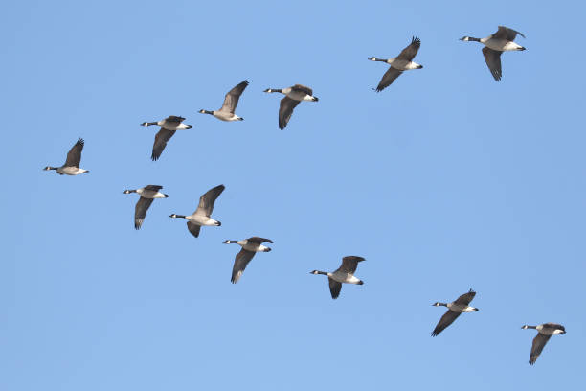
Lessons From The Geese
Notice how the geese fly on their long flight of migration …

Slide 31
Leadership
What is Leadership? : Influencing people directing towards the goal.
Leadership is concerned with people and helping them to have a purpose and striving to achieve it.
Who is Leader? A Leader shares power with others, controls processes, confers freedom of action and demand performance.

Slide 32
Leadership Function ( Adair Model)
Task function
Defining the tasks
Making a plan
Allocating work and resources
Controlling quality and tempo of work
Checking performance against the plan
Adjusting the plan
Team function
Setting standard
Maintainance discipline
Building team spirit
Appointing sub Leader
Individual functions
Attending to personal problem
Praising individuals
Giving status
Recognising and using individual abilities
Training to individuals

Slide 33
Types of Leadership
Autocratic/authoritative
S
Democratic/ Participative
S
S
L
S
S
L
Leadership
S
S
Free Rein: Free control
S
S
S
S
L

Slide 34
Changing pattern of leader-subordinate relationship
Use of authority
by leader
Area of Freedom for subordinate
Tells Sells Consult
Shares
Delegates
Makes decision and announces it
Makes decision and explains it
Get suggestion then makes decision
Define limits and lets group make decision
Allowed subordinate to function with defined limits

Slide 35
TRAITS of Leaders
Honesty
Competence
Credibility
Inspiring
Courageous
Forward Looking

Slide 36
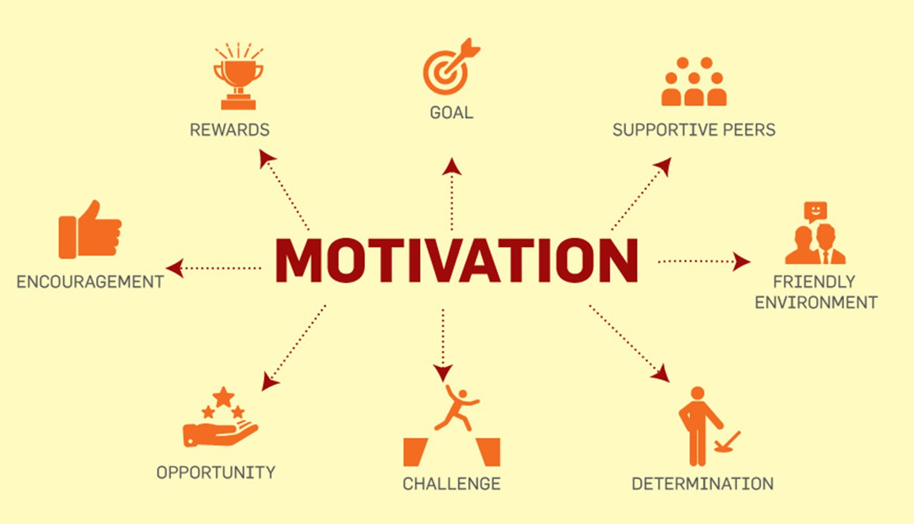

Slide 37

What is motivation?
The term 'motivation' can be used to describe anything which causes people to accomplish more than they would otherwise achieve.

Slide 38
FUNDAMENTALS OF MOTIVATION
Motivation is highly individualized phenomenon.
Motivation is situational and role related phenomenon
Motivation has something to do with subordinates, but nothing to do with superior.

Slide 39
THE REWARD SYSTEM FOR MOTIVATION
TOTALITY OF ECONOMIC AND NON ECONOMIC COMPENSATION THE ORGANISATION OFFERS ITS EMPLOYEES.
It Serves:
To attract
To retain
Motivate employees
Maintain employee morale
Prepare employees for greater responsibilities

Slide 40
Trust
Recognition
Appreciation
Growth
Encouragement
Balance
Responsibility
Efficient
Fair Working Environment
Non-Financial Rewards

Slide 41
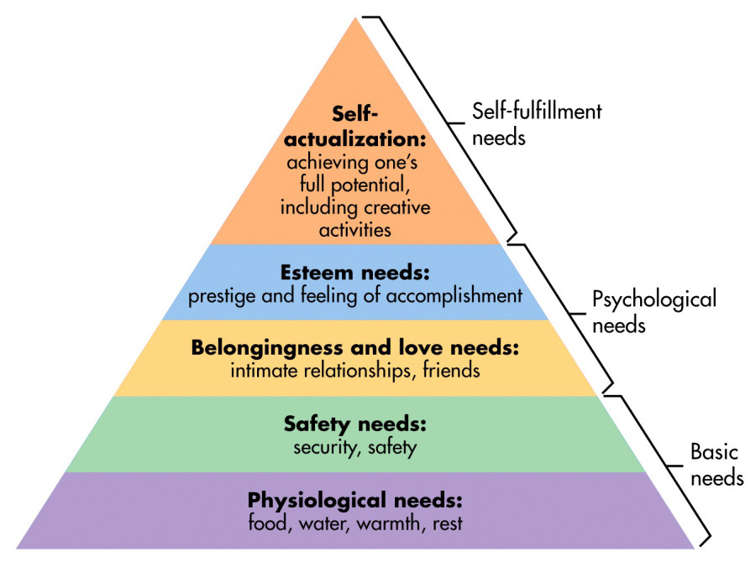
Maslow's Hierarchy of Need

Slide 42
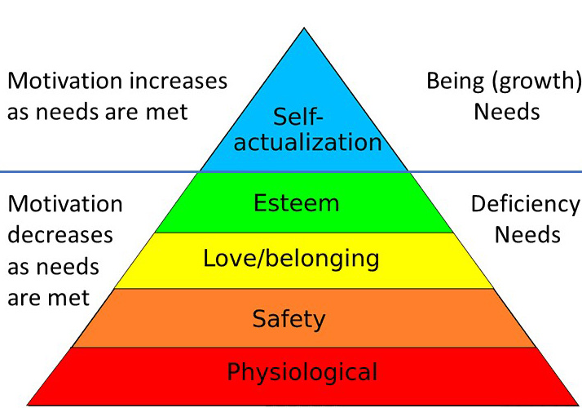
Deficiency needs vs. growth needs

Slide 43
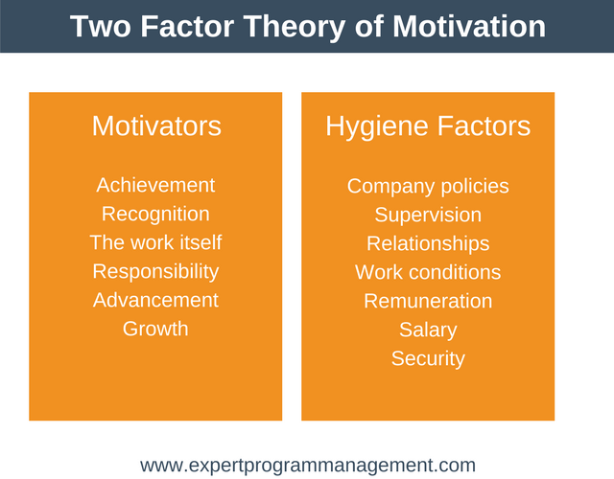
Herzberg’s –Motivation- Hygiene Theory
Satisfying factor =========== Motivation
Dissatisfying factors ========== Hygiene

Slide 44
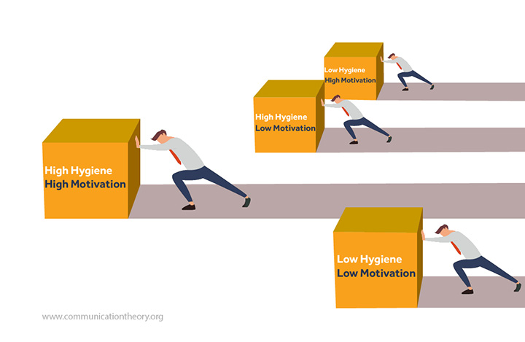
The Four States

Slide 45
Hygiene Stressors Eliminator
Rectify petty and bureaucratic company policies.
Ensure each team member feels supported without feeling micromanaged. You can do this by using servant leadership or a democratic leadership style.
Ensure the day to day working culture is supportive. No bullying. No cliques. Everyone treated with equal respect.
Ensure that salaries are competitive within the industry. Ensure there are no major salary disparities between employees doing similar jobs.
To increase job satisfaction and status, aim to construct jobs in such a way that each team member finds their job meaningful.

Slide 46

Intelligence

Slide 47
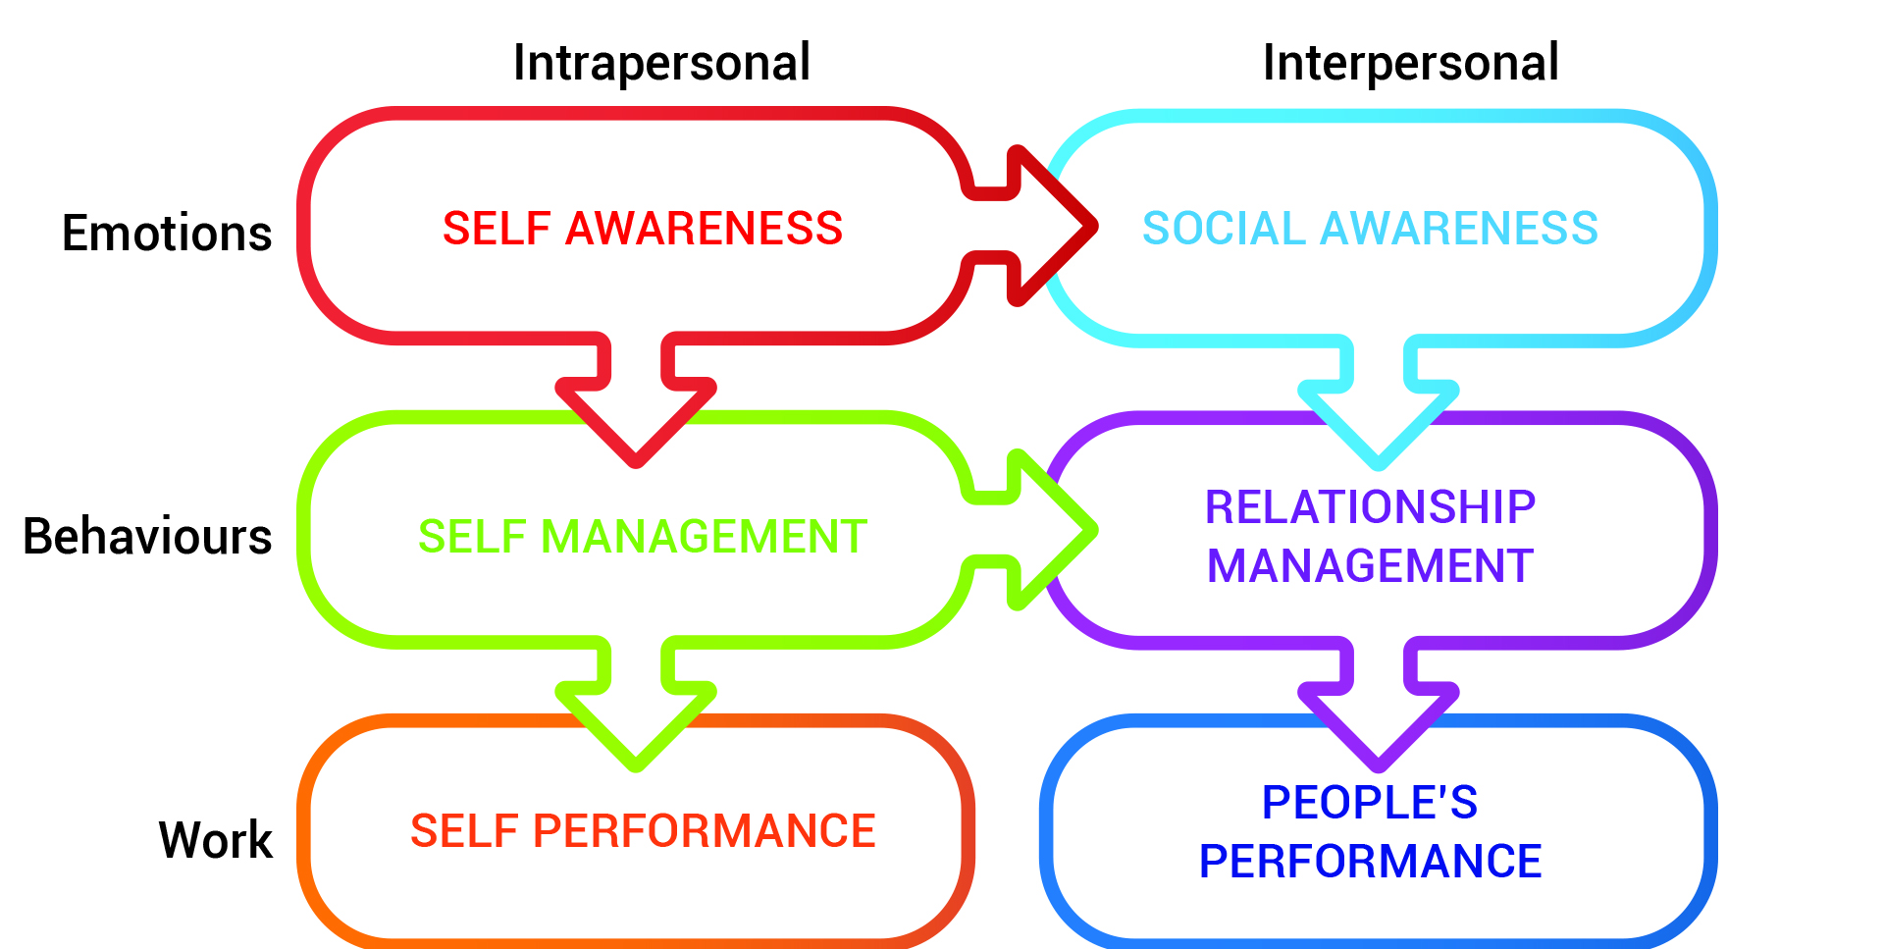
Emotional Intelligence

Slide 48
Personality Type
Type A | Type B
Very restless, Can do Immediately, Need result Immediately | Very steady, Do with thinking & slowly. For result there is no hurry
It is good or bad but situation dependent | It is also good or bad but situation dependent
Personality Control Locus
Internal Locus of Control of Personality | External Locus of Control of Personality
Always find mistake of own: | Mistake is of other always, Don't look the mistakes of own. Question was tuff for that result is poor
Can be controlled by own self | Can not be controlled by own
Developmental as can check | Detrimental as can not be checked

Slide 49
Constituents of Emotional Intelligence
According to Daniel Goleman, there are five main elements of emotional intelligence:
Self-awareness
Self-regulation
Motivation
Empathy
Social skills

Slide 50
Constituents of Emotional Intelligence
Self-awareness: The ability to recognize & understand own moods, emotions and drives.
Self Regulation: The ability to manage one’s own emotions and impulses
Leaders who regulate themselves effectively rarely verbally attack others, make rushed or emotional decisions, stereotype people, or compromise their values. Self-regulation is all about staying in control.

Slide 51
Constituents of Emotional Intelligence
Motivation: Self-motivated leaders work consistently toward their goals, and they have extremely high standards for the quality of their work. They also have the ability to persist in the time of failure. They have the strong desired to achieve and also have organizational commitment.
Empathy: The ability to understand the emotions, feelings & need of others. Skill in treating people according to their emotional need

Slide 52
Constituents of Emotional Intelligence
Social skills: Proficiency in managing the relationship & building network. An ability to find common ground & build rapport.
Hallmark of social skills:
Effective Communication,
Listening ability,
Persuasiveness & conflict management,
Expertise in team building

Slide 53
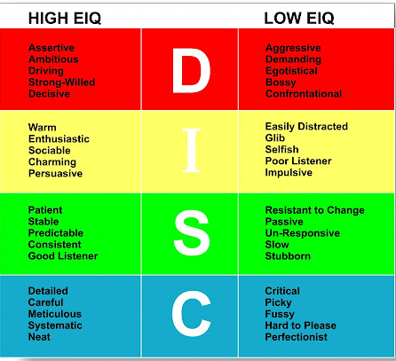

Slide 54


